Slide 1




ENERGY VALVE 3.0
Solving Low Delta T Leveraging IoT

Slide 2


Agenda
  Low Delta T
  Features and Benefits
  Success Stories
  Product Range Overview
  Industry Recognition
Notes:
Agenda Slide
A guide through the presentation starting with the problem that the Energy Valve solves Low Delta T
Then moves to the solution in the Energy Valve describing an overview for those that are new to the energy valve and then to the features of EV3
Overview of a couple of success stories more are available on Energy Valve.com
Line overview showing wide flow and pressure range and pricing
Industry recognition as a closing showing the success and acceptance of the product in the market

Slide 3
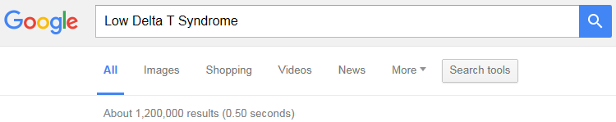
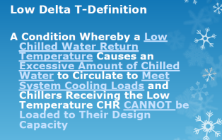
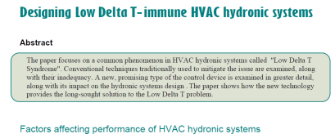
Low Delta T Syndrome is Industry Wide
Notes:
Low Delta T Syndrome is Industry Wide
This slide shows helps set the stage for the problem there have been numerous studies and papers written explaining the impact of Low Delta T. A simple Google search for Low Delta T Syndrome reveals 1.2 million findings related to the topic

Slide 4
Low Delta T May Occur When
Coils and valves are not sized properly
Systems are not dynamically balanced
Coils foul and degrade with age
or lack proper maintenance
Too much water is delivered
Notes:
Low Delta T may occur when
Oversized Valves have low valve authority. This authority is exasperated during low load conditions.
Systems are not dynamically balanced. Systems are typically balanced which is performed at design conditions which does not occur often typically only a handful of days a year. Systems change
over time from maintenance or additions to system and Re-balancing is not common the Energy valve dynamically balances at all loads offering system stability and efficient operation
Coils degrade over time. Without proper maintenance, the coil output is reduced leading to low heat transfer.
Flow rate in excess of what it needed leads to Low Delta T overflowing the coil this point transitions to the next slide to explain coil behavior

Slide 5

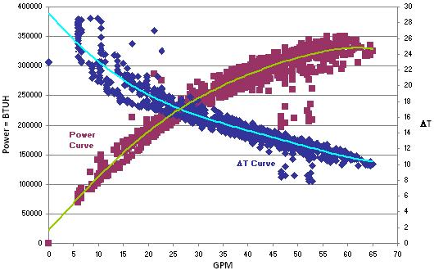
Low ΔT Reduces Heat Transfer at the Coil
Increased flow does not always produce more power instead it saturates the coil.
Notes:
Low Delta T Reduces Heat Transfer at the Coil
Basic explanation of the relationship between coil power and Delta T.
Red scatter is data points of coil power with a yellow best fit line to normalize the data
Blue scatter is data points of coil power with a blue best fit line to normalize the data
As flow increases Delta T decreases
In this example the coil curve starts to flatten and saturate at about 55 GPM and additional flow is being wasted as it is not producing additional BTU

Slide 6
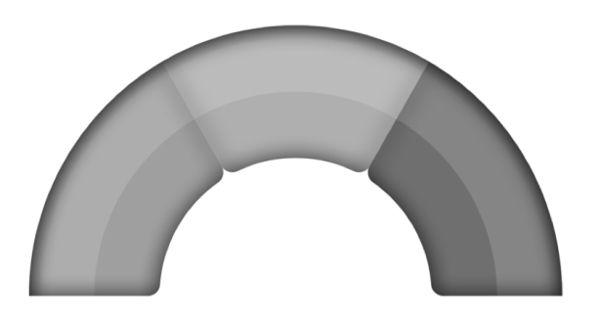
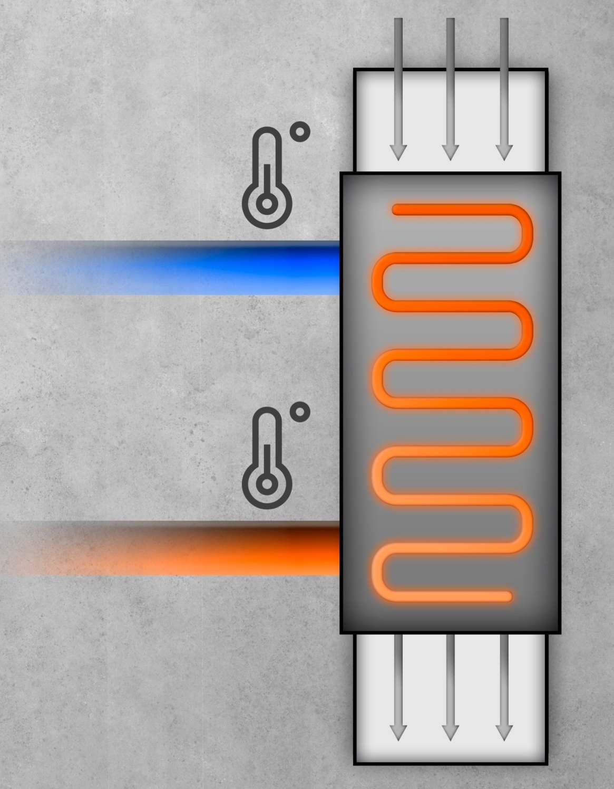




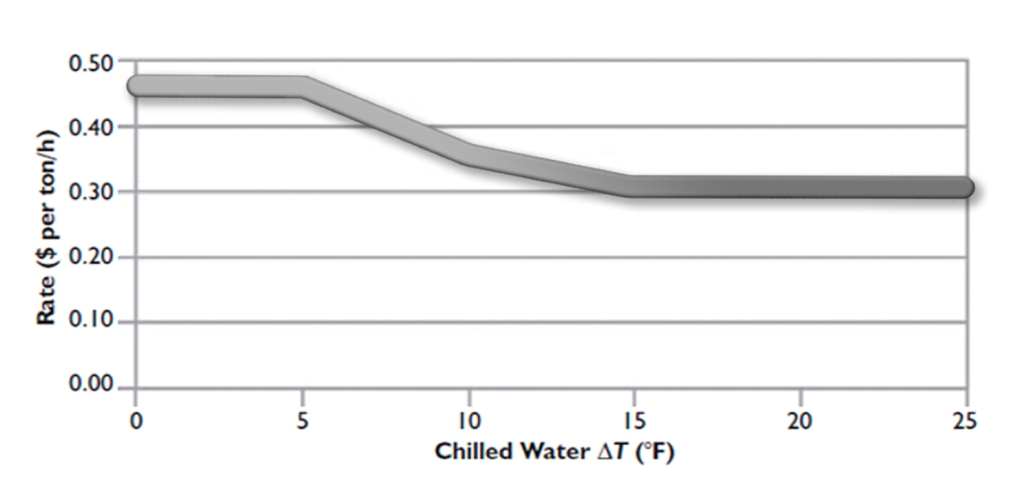

Central Plants Increase Rate for Low Delta T
MEDIUM
FLOW
LOW
HIGH
42° F
8°F
16°F
Entering water
DELTA T
LOW
MEDIUM
HIGH
$ PER TON/H RELATIVE TO DELTA T
58° F
50° F
Return water
Notes:
Central Plants Increase Rate for Low Delta T
Central Plants charge based on the Delta T the lower the Delta T the higher the rate
Low Delta T forces the chiller plant to meet a volumetric increase
They also have demand hours that in peak times the charges are even higher similar to how electric company peak hours
It is not un common for charges for low Delta T to be in the order of $40,000 per month

Slide 7
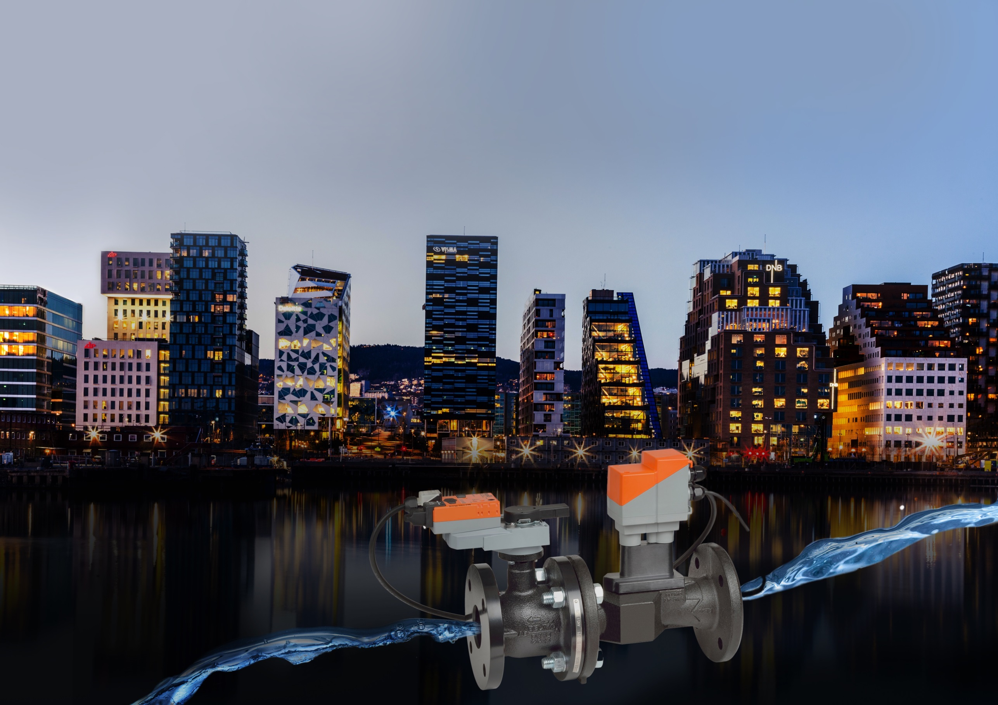






  Energy Valve 3.0
The world’s most
advanced pressure-
independent valve
Notes:
Energy Valve 3.0
Here is the introductory slide to the EV3.0
A significant investment by Belimo in terms of engineering resources and capital one of the largest Belimo projects
New Features will be in the following slides

Slide 8
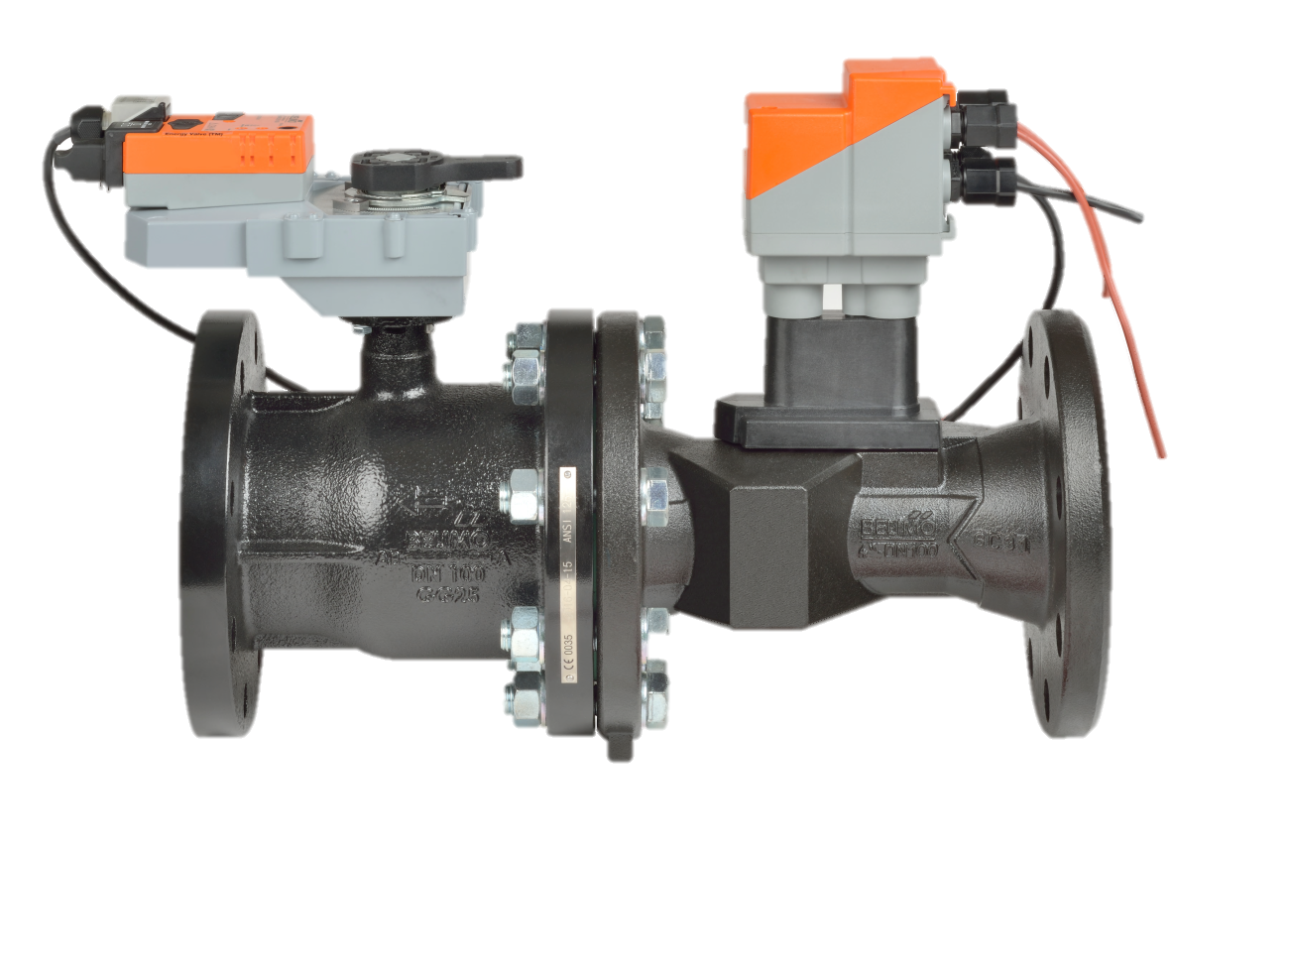
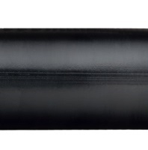


Energy Valve Overview
1
Actuator
Webserver, data logger, BACnet, Modbus, MP-Bus, Cloud capability
4
1
2
2
Electronic Flow Meter
True Flow, Wet calibrated
3
3
Temperature Sensors
Platinum based RTD for supply and return, allowing BTU measurement
4
Logic
Delta T Management, Cloud Optimization, Power Control algorithm
Measure, Observe, Record and Trend Performance Data

Slide 9






  New Features
Enhanced Delta T Management
Ultra Sonic Flowmeter
Glycol Monitoring
Enhanced User
Interface
Cloud-Based
Services

Slide 10


Enhanced Delta T Management

Slide 11
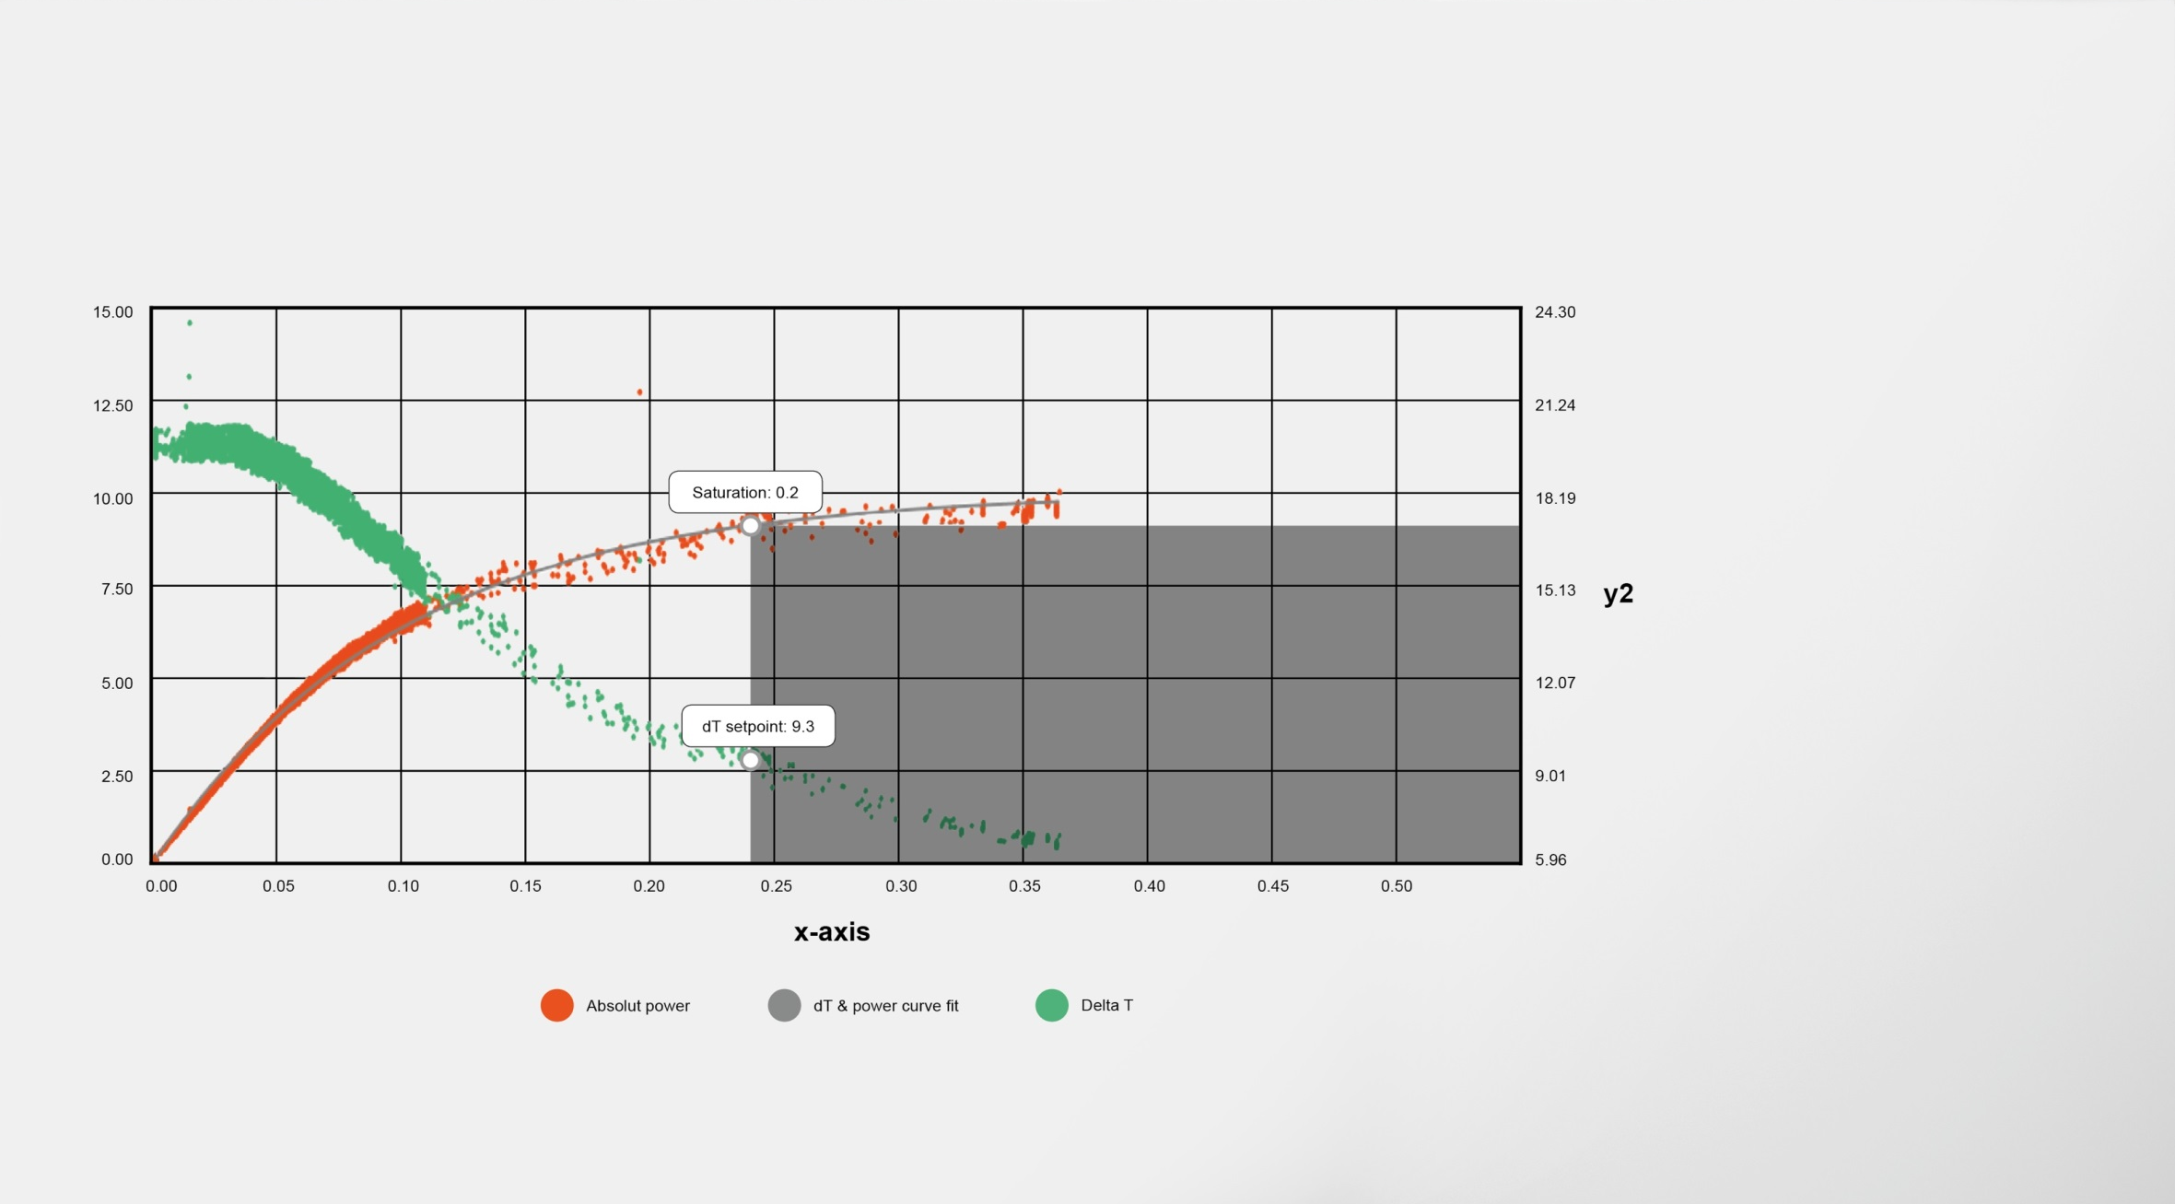
More Savings
Coil Optimization
Expanded Delta T range
2°F to 100°F
[1.1°C to 55.5°C]
Dynamic coil performance provides transparency of changes in load and usage patterns
Integrated Delta T setpoint
Notes:
More Savings
Expanded Delta T Range for heating applications, Heat exchangers and helps us position to achieve EN1434 European heat metering standard. 2 Degree Delta T is not common in systems but can be utilized to analyze a system if desired.
Transparency of load updated dynamically providing visibility to load and usage patterns, and predictive coil maintenance.
The Delta T set point suggestion is integrated and exporting to the data analysis tool is no longer needed
The lower limit on the Delta T Manager has been enhanced providing more savings at partial load. This is an option which is selected in webview. The default is still 30% of Vmax, the new option can go all the way down to 10% of Vnom

Slide 12

Ultrasonic Flow Meter

Slide 13
Advanced Ultrasonic Sensor Technology
1
True Flow
Actual flow measurement as opposed to calculation like mechanical PI valve
1
4
2
Wet Calibrated
Individually calibrated to ensure accuracy and repeatability
3
2
3
Temperature and Glycol Compensation
Ensures accuracy over entire temperature range and varying glycol concentration
4
Glycol Monitoring
Provides actual glycol % for safe operation and optimized heat exchange
Notes:
Ultrasonic Flow Meter
Belimo Designed Ultrasonic launching in September
Rangeability 100:1
6 X higher resolution than Electromagnetic
+/- 2% reading of flow rate
How glycol Monitoring works is by using the internal temperature sensor in the ultrasonic flow meter and the speed of sound from the flow meter.
Having these two pieces of information there is a cross reference table in the actuator of speed of sound and temperature that indicates for specific speeds of sound and temperatures it solves for the glycol %.

Slide 14

Glycol Monitoring

Slide 15
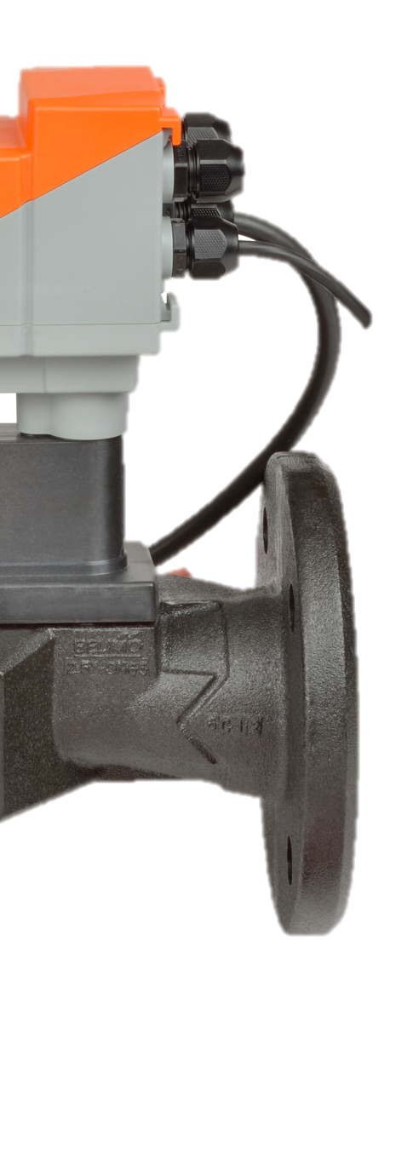


Glycol Monitoring
Ensures concentrations meets design needs
Glycol content above the design concentration:
Increases fluid viscosity which reduces pumping efficiency
Heat transfer effectiveness of the coil degrades
Critical zones may be starved
Results in loss of comfort
Glycol content at ideal level:
Increases overall heat transfer
Increases pumping efficiency
Reduces operating costs
Glycol content below the design concentration:
System at risk of freezing
Imposing costly repairs
Risk of damaging the building
Notes:
Glycol Monitoring Benefits
Glycol concentration and pump efficiency are linked the higher the concentration the more viscous or thick the media becomes creating additional pressure requiring additional pump head
Glycol concentration and heat exchange are linked and excessive concentrations have a negative effect on heat exchange and will create inability to hit discharge air set point
In cold environments glycol concentration is essential not having this could cause coils to freeze and or become damages causing costly repairs to the building and system
There is also a financial savings having this monitoring integrated into the valve. One eliminates the need for additional refractometer, eliminates the need for additional control point to integrate this refractometer ($600-$1500) also glycol is not wasted being added in excess as it is now continuously monitored

Slide 16

Enhanced User Interface

Slide 17
Enhanced User Interface
Streamlined design
Live data points
Notes:
The User Interface has been completed redesigned with a streamlined approach. This Overview page is the main page for information and data points on the screen are live showing data in real time and upon clicking on them a chart of historical operation can be viewed. Also if there is an error on a data point such as flow or temperature. There are help Icons that take the user directly to the trouble code where there will be suggestions on how to correct the error

Slide 18
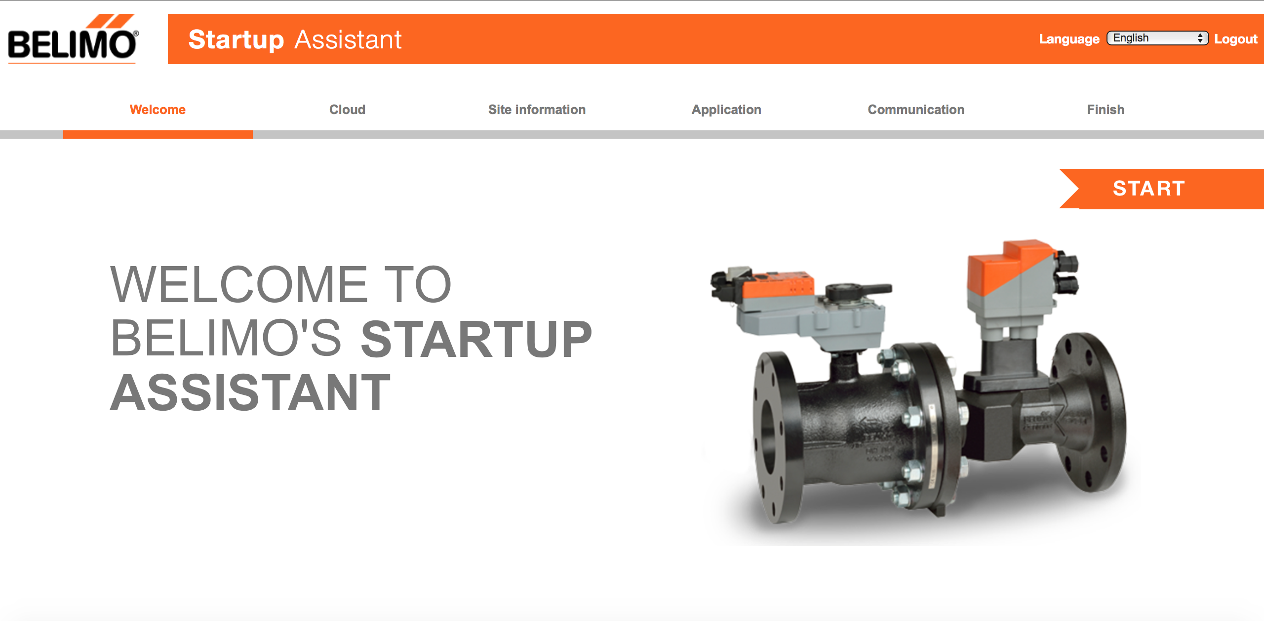
Enhanced User Interface
Guides through valve set up
Notes:
Startup wizard provides immediate familiarity with the valve guiding the user through set up.
Runs when the valve is initially powered up and settings selected during ordering are already populated
Can be run as often as desired it is located on the application page of the setting menu

Slide 19
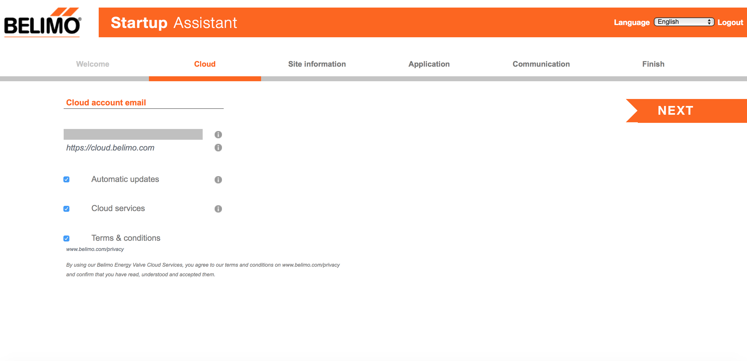
Enhanced User Interface
Software update capability
Notes:
It is possible to have software updates via the cloud if connected or can be loaded on the actuator if not connected to the cloud. These will be for updated related to security, and operation not upgrading from EV2 to EV3

Slide 20
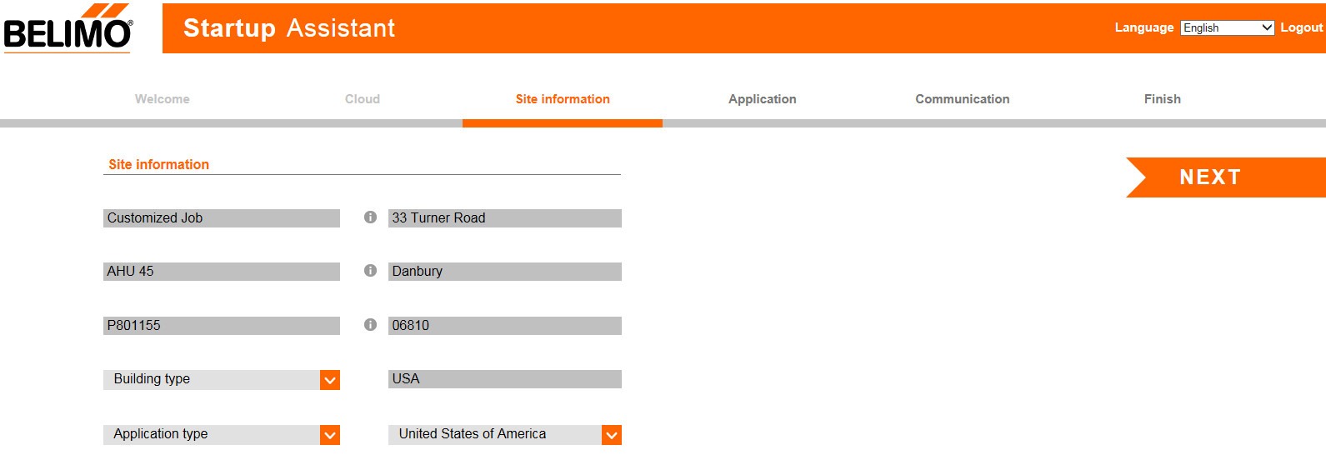
Enhanced User Interface
Customize job specific information
Notes:
Customizable pages provide ability to define AHU location and other user specified information
Also during the startup assistant there is possibility to add site information The first two entries on the left will be displayed on the webpage and the others will display when the actuator is connected to the cloud.

Slide 21
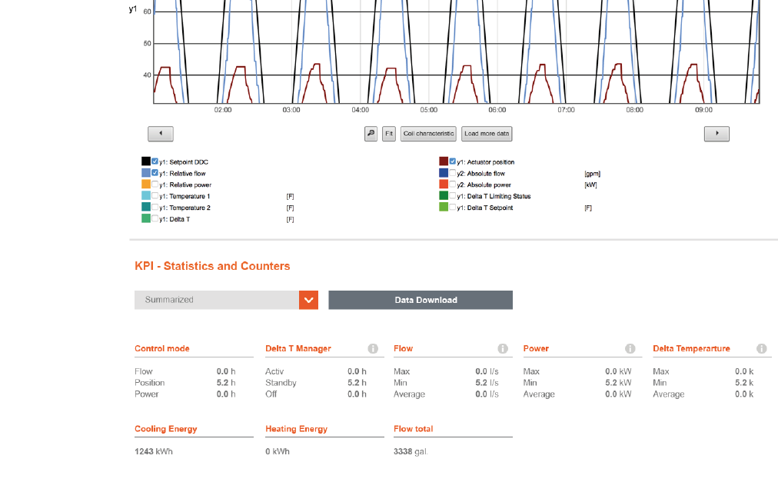
Enhanced User Interface
KPI’s & multiple
data file downloads
Notes:
Key performance indicators including, time in particular control mode, Delta T Manager activity, total flow, energy and operational statistics graphically illustrated

Slide 22
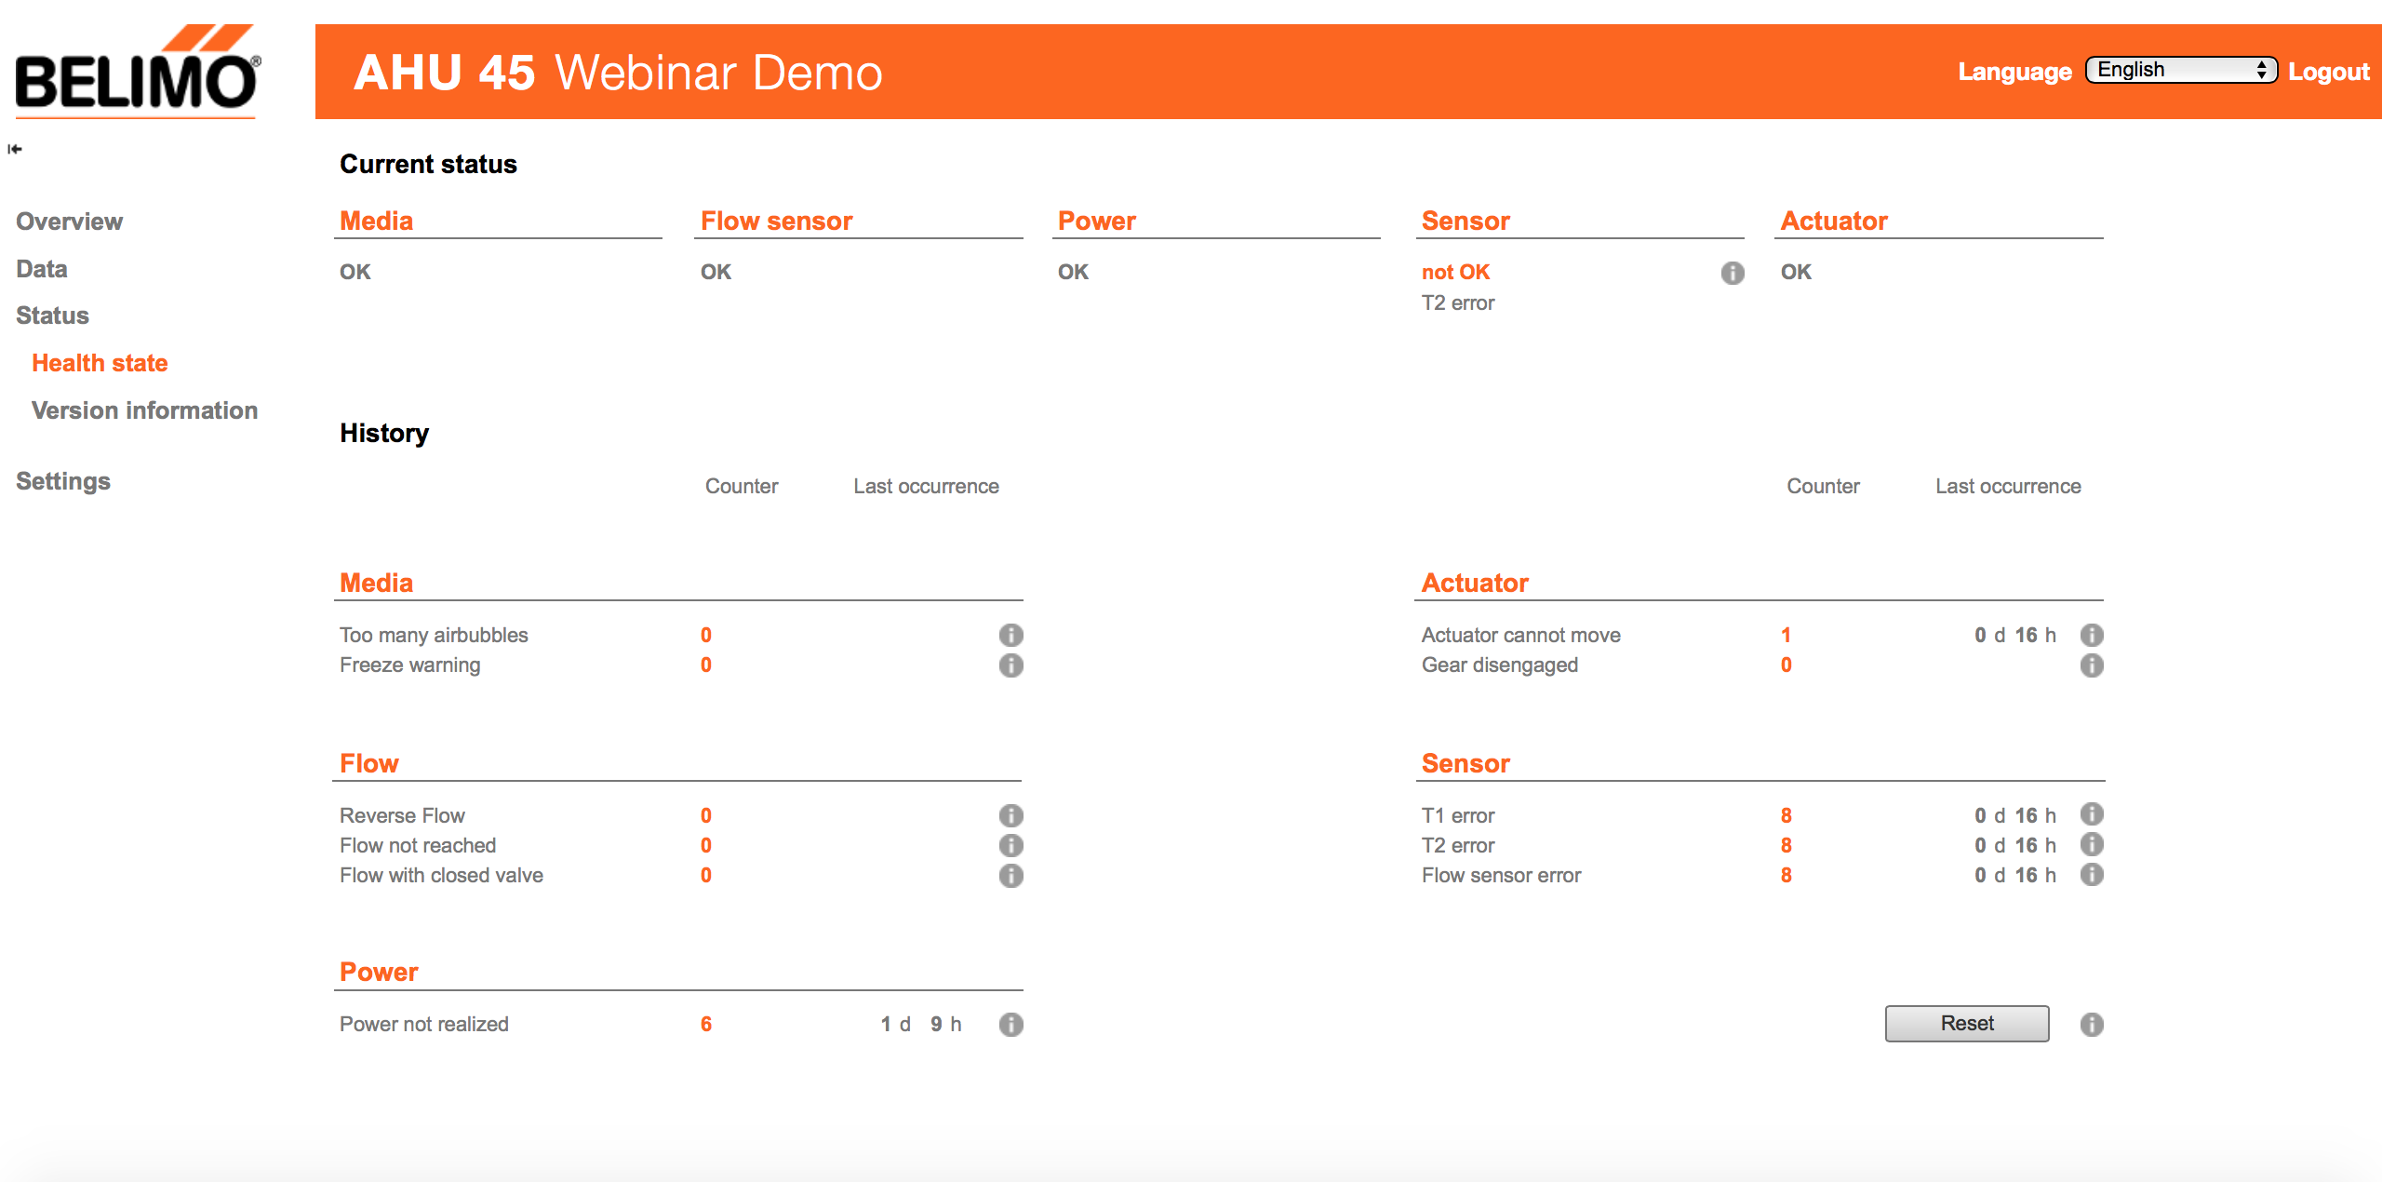

Enhanced User Interface
Improved
troubleshooting
information
Notes:
Improved troubleshooting with informational help buttons that provide suggestions to correct errors

Slide 23
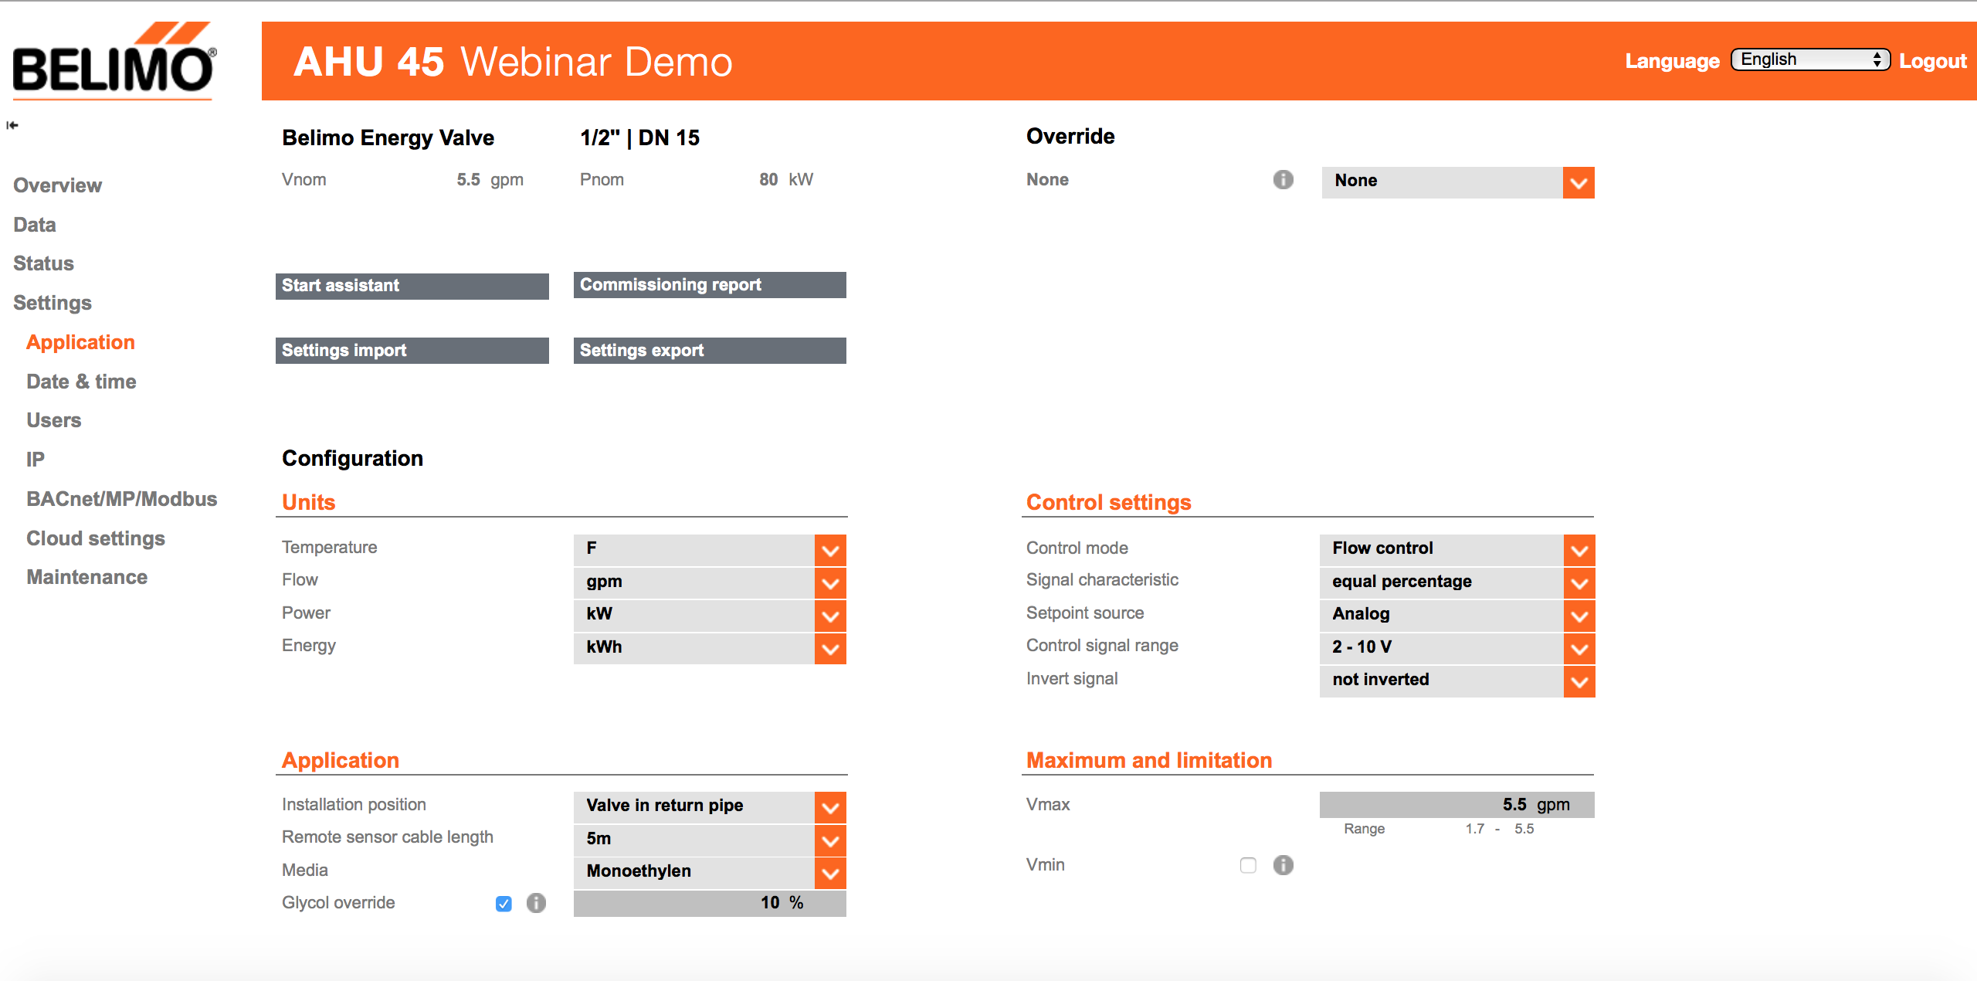
Enhanced User Interface
Commissioning
report provides
verification
of setup
Notes:
Generates a PDF of the valve settings that can be used to verify valve set up and prove correct set up

Slide 24
Enhanced User Interface
Save and reload settings from
one valve to another
Notes:
Allows for setting up multiple valves quickly exports an XML file that can be loaded into another valve. The valves need to be the same size but the file can be edited to adapt to different size valves

Slide 25
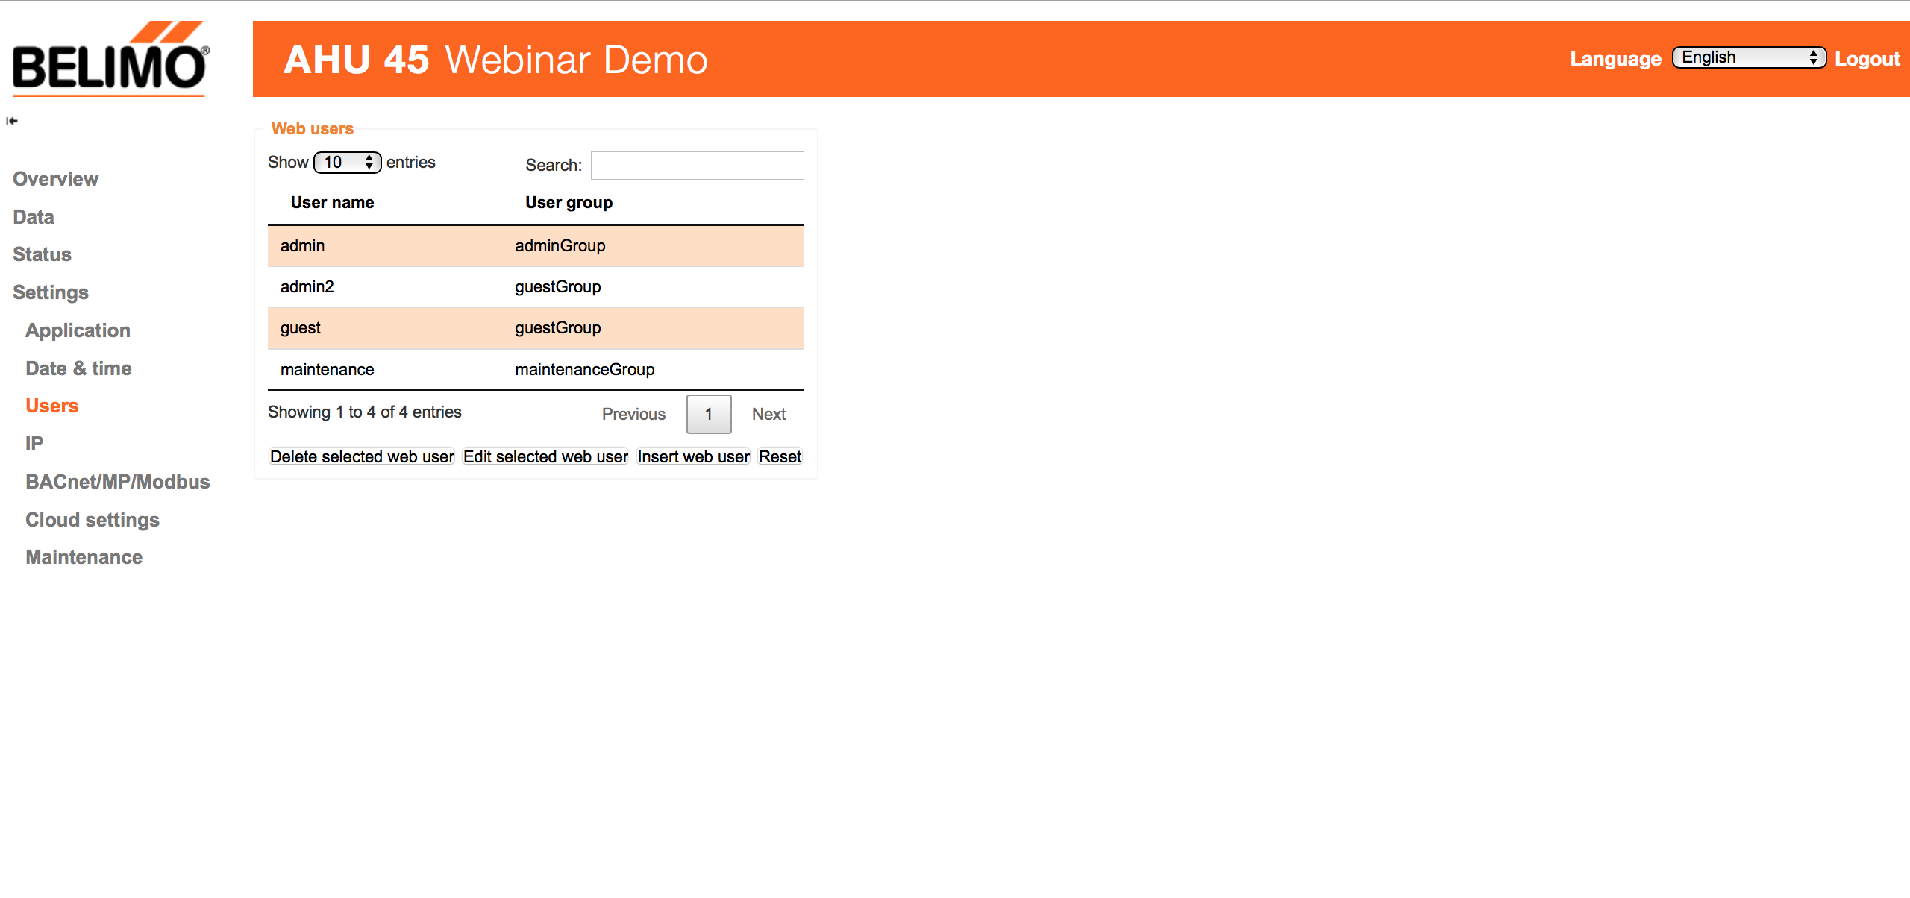
Enhanced User Interface
User
administration
Notes:
User Administration allows for addition and deletion of users and full password functionality. This is for advanced users that require the ability to change passwords. There is also a recommendation to change the password at the end of the startup assistant

Slide 26


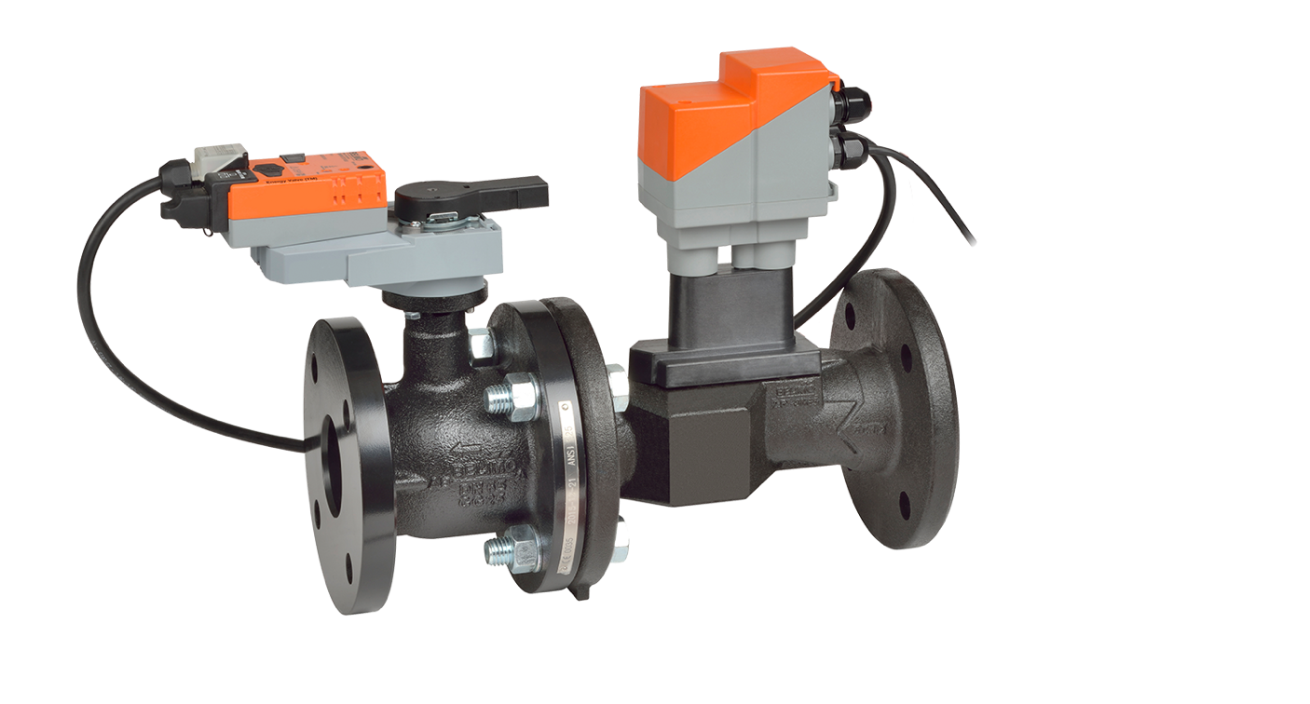
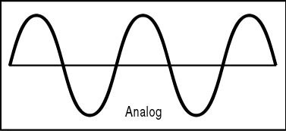
Enhanced Communication
Unlike any actuator on the market
ANALOG
2-10 VDC
0.5 -10 VDC
Notes:
No other actuator on the market today has more ways to communicate
New for 3.0 Modbus and cloud connectivity

Slide 27
Cloud-Based
Services

Slide 28


Leveraging the Belimo Cloud
Cloud-Based Services
Remote cloud communication to monitor energy usage and leverage system data
Automatic Optimization
Capture system data to automatically improve coil and system performance via advanced analytic technology
Advanced Efficiency
Increase plant efficiency and mitigate the Low Delta T syndrome to reduce pumping and chiller/boiler operating costs
Notes:
Bellimo has always been a technology leader so the transition to cloud technology is a natural step.
The competitive edge will be leveraging the data, it is all about the data
With Belimo having valves located all over the world and having the same valve characteristics in terms of flow curves and geometry the missing variable is the system data. Having this system data allows Belimo to further advance the products in terms of optimizing systems. Machine learning can crunch this data to drive valve and system performance
Belimo is taking efficiency to a higher level

Slide 29

Energy Valve 3.0 Cloud Services
Advanced optimization with multiple benefits
OPTIMIZATION OF DELTA T AND FLOW SETTINGS
PERFORMANCE REPORT
ONLINE SUPPORT
SOFTWARE
UPDATES
INCREASE WARRANTY TO 7 YEARS
LIFETIME
DATA ACCESS
Notes:
The cloud based services are a complement to the product and are offered at no additional cost and will be discussed in detail in the upcoming slides
Now Optimization is automatic via the cloud the optimal Delta T and flow set points and be sent to the valve automatically or can be set manually by the user. Either way they receive an email of the proposal/changes
This now provides an advanced level of optimization with cloud based data optimization via machine learning. It takes the labor out of analyzing data.

Slide 30
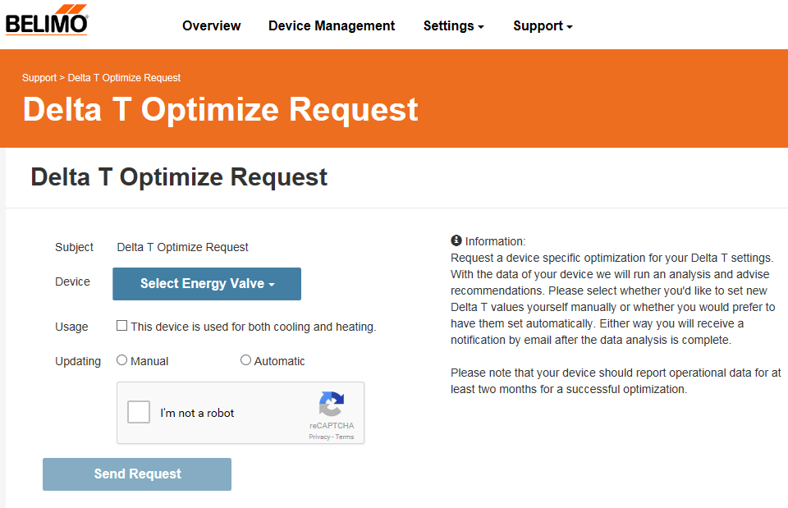
OPTIMIZATION OF DELTA T AND FLOW SETTINGS
Better performance and system stability
Ensures effective use of the Delta T Manager
Cost savings through efficient operation
Notifications of any system changes
Notes:
This ensures that the Delta T Manger is being used and being used correctly and effectively.
Operating at the optimal settings will provide better performance and overall system stability.
Utilizing the Delta T Manager optimally will also provide pump savings operating the coil at the design Delta T
The customer will receive via email recommendation for Delta T and flow set points based on the data from that valve. There needs to be at least two months of data loaded for a recommendation
These can be either manually loaded or automatically loaded. If the valve is used for both heating and cooling which is determined by the customer and needs to be entered when requesting optimization of Delta t and flow settings it can only be implemented manually.

Slide 31
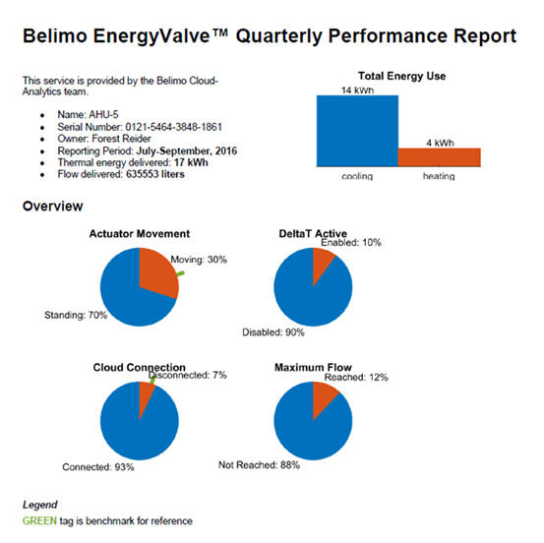
PERFORMANCE REPORTING
Automatically generated performance report with key insights
Eliminates need to analyze data
Allow for predictive maintenance of coil performance and easy ROI analysis
Notes:
Performance reporting
Quarterly report of valve operation including total flow rates, Energy usage, Delta T Manger usage, trouble codes triggered and coil plot
This proves valve performance and operation
Provides a tool for predictive maintenance from transparency of coil performance

Slide 32
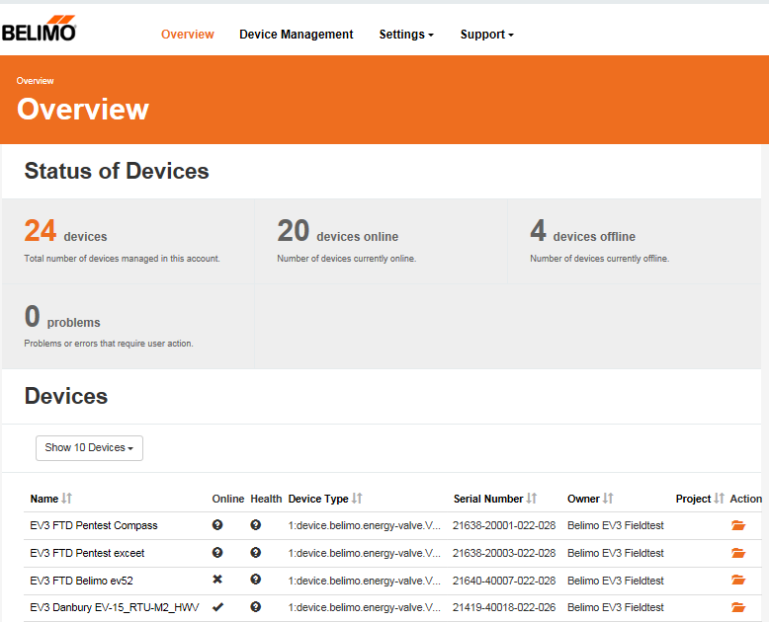
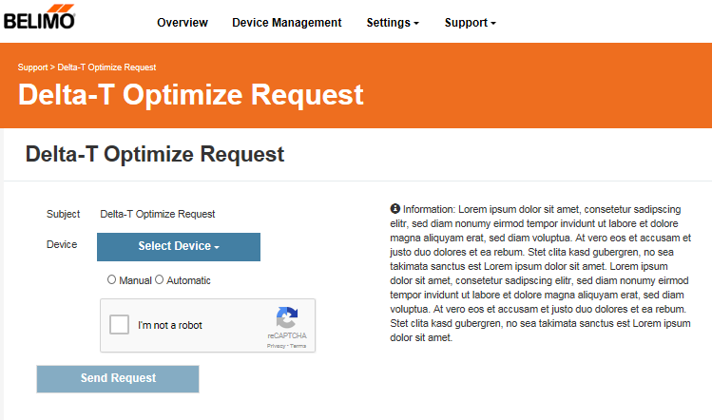
BELIMO ONLINE SUPPORT
Real time troubleshooting reduces downtime
Fast response
Direct connection to Belimo experts
Notes:
Allows for our technical support team to log directly into the valve seeing real time of set points.
Will reduce down time from faster response

Slide 33
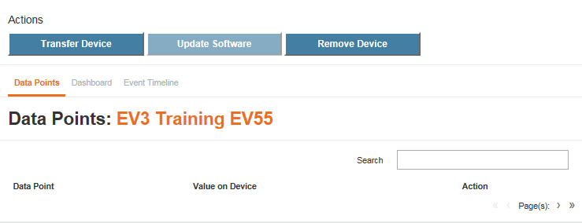
SOFTWARE UPDATES
Latest software and security updates automatically provided for maximum productivity and reliability
Uninterrupted service
Direct notification via email
Notes:
Updates for security and productivity only
This will not be used to upgrade from EV2 to EV3.0
Can be automatically loaded or user loaded either way will receive an email that they are available

Slide 34
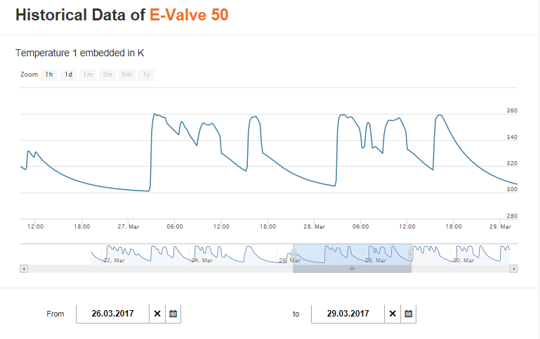
LIFETIME DATA ACCESS
Secure data and password management
Lifetime access for future optimization
Easy-to-use interface
Single, secure repository
Simplified overview of KPIs
Notes:
Lifetime data access
Provides value in terms of data storage eliminating the user from purchasing additional storage
Consolidates all data for all valves in one location, very helpful if the user has multiple buildings
Stored, backed up and secure for the lifetime of the valve
Data export is similar to the .csv format from the actuator

Slide 35
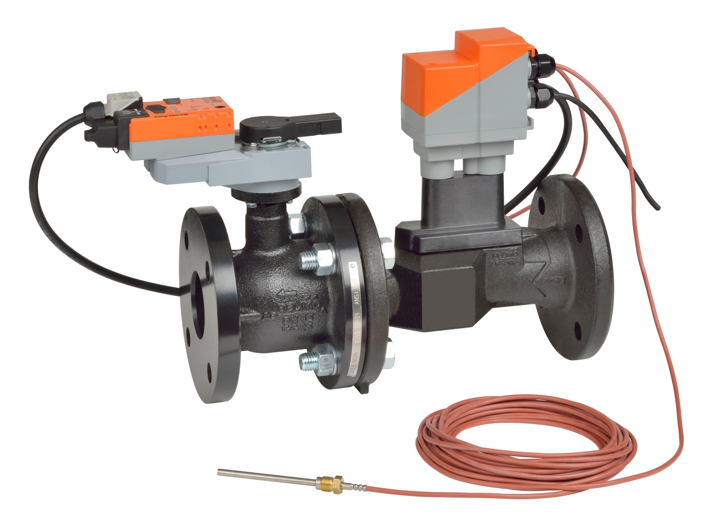
EXTENDED WARRANTY
Peace of mind
Reduce maintenance budget
Reminder of warranty status
Statement of Belimo quality

Slide 36
One Valve So Many Benefits
Enhanced Delta T Management
Ultra Sonic Flowmeter
Glycol Monitoring
New User
Interface
Cloud-Based
Services
Pressure
Independent Control
Hydronic
Balancing
Notes:
Seven Functions in one valve

Slide 37
Most Capable Valve in the HVAC Industry
Feature | Typical PI* | Original Energy Valve | Energy Valve 3.0
IoT Device |  |  | ✓
Cloud Analytics |  |  | ✓
Glycol Monitoring |  |  | ✓
Commissioning Report |  |  | ✓
True Flow |  | ✓ | ✓
Dynamic Balancing | ✓ | ✓ | ✓
Energy Meter |  | ✓ | ✓
Power Control |  | ✓ | ✓
Delta T Manager |  | ✓ | ✓
Live Data |  | ✓ | ✓
Coil History |  | ✓ | ✓
CCV Technology** |  | ✓ | ✓
Leakage | ANSI Class IV | 0% | 0%
High Close-off |  | ✓ | ✓
Low Minimum Pressure Drop |  | ✓ | ✓
Field Configuration | ✓ | ✓ | ✓
Bus Communication |  | BACnet MS/TP or IP and MP Bus | BACnet MS/TP or IP, Modbus RTU or TCP/IP and MP Bus
Password Configuration |  |  | ✓
Set-Up Wizard |  |  | ✓
5-Year Warranty | ✓ | ✓ | ✓
7-Year Warranty with Cloud Access |  |  | ✓

Slide 38


Success Story
Massachusetts Institute of Technology (MIT)
CASE STUDY
Massachusetts Institute of Technology (MIT)
Average Delta T rose from 6.15°F to 12.14°F, reducing chilled water flow by
Annual savings were estimated to be as high as
Average Delta T rose from 6.15°F to 12.14°F, reducing chilled water flow by
Annual savings were estimated to be as high as
49%
$1.5 million
49%
$1.5 million
Notes:
MIT Success story
One of our most prestigious success stories
Building and Project Details
150,000 sq. ft. on 3 floors
Built in 1947 (originally had its own dedicated chiller, later converted to campus district cooling)
6 AHU provide majority of the cooling
Average delta T coil = 6.15°F before Delta T Management
Results
Aug 9 - Oct 9, 2010 DT = 6.15 F
Aug 9 - Oct 9, 2011 DT = 12.14 F

Slide 39
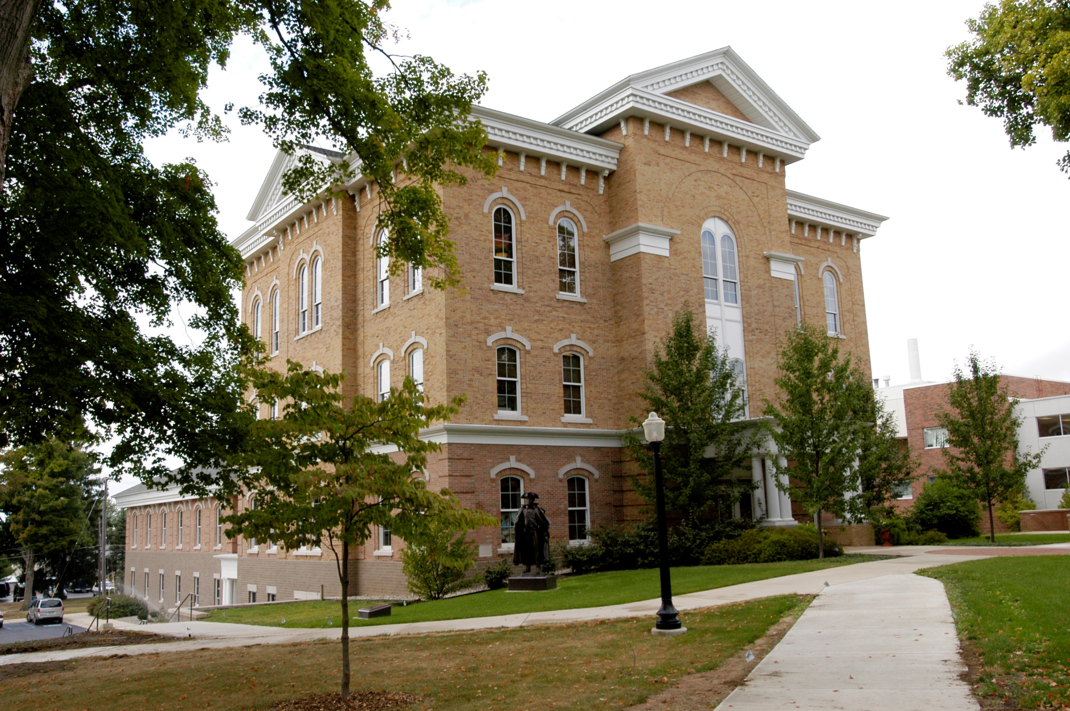


Success Story
Hillsdale College Mossey Library & Delp Hall
Delta T Increased
3-7°F to 10-12°F
reducing usage of chiller by
Electricity consumption reduced by as much as
  300 hours/year
16%
Notes:
In the spring of 2013, Hillsdale College made the decision to install three Energy Valves as part of a pilot test. Two of the valves were installed in the campuses
60,800 SF Mossey Library and the third in Delp Hall, a 20,000 SF square foot
Increased chilled water Delta T across coils to their design of 10 -12°F
Used feedback data from Energy Valve to control pumps with variable frequency drives (VFDs), allowing for more precise control of the chilled water
loop without sacrificing the AHUs call for cooling during occupied times.
After the success of the pilot test, the decision was made to install additional Energy Valves throughout the campus. Over the course of the next year (from May of 2014 to May of 2015), 24 Energy Valves were installed in 11 buildings across the main chilled water loop (sizes from 1/2 to 4-inch). In some coils, deltaT’s were seen as high as 30°F while sufficiently maintaining the air handler’s desired discharge air cooling temperature.

Slide 40
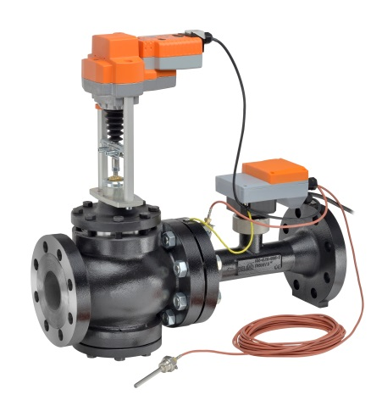
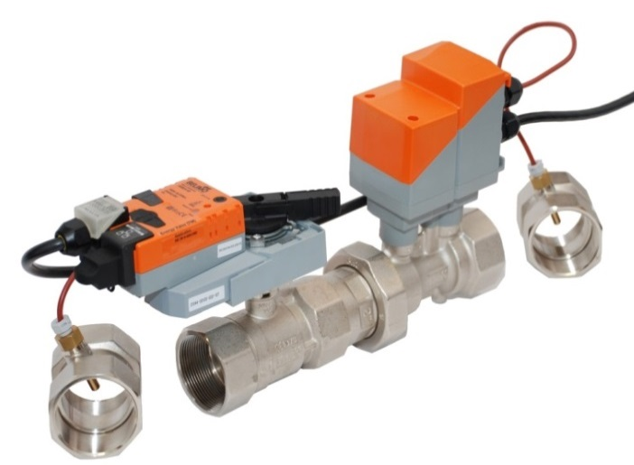
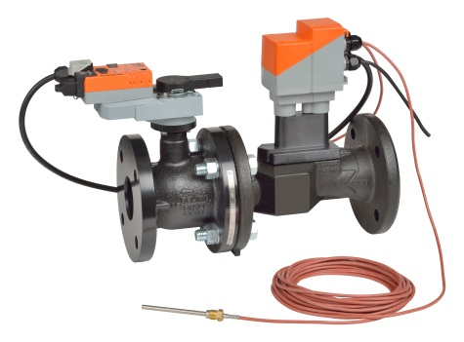
Wide Range of Flow and Pressures
New Ultrasonic
Size: ½” to 2”
GPM: 1.65 to 100
Ends: NPT
Size: 2.5” to 6”
GPM: 38 to 713
Flange: ANSI 125
Size: 2.5” to 6”
GPM: 38 to 713
Flange: ANSI 250
Q3 Launch

Slide 41
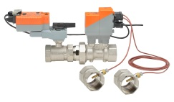
Pricing NPT
ACTUATOR PART # |  |  |  |  | LRX 24-EV | LRX24-EV-G | NRX24-EV | NRX24-EV-G | ARX24-EV | ARX24-EV-G | AKRX24-EV | AKRX24-EV-G
GLYCOL MEASUREMENT |  |  |  |  |  | · |  | · |  | · |  | ·
MODEL # | GPM | SIZE | BODY PRESSURE RATING (PSI) | CLOSE-OFF PRESSURE (PSI)
EV050S-055 | 5.5 | 0.5” (15) | 360 | 200 | $1,341 | $1,740 |  |  |  |  | $1,949 | $2,348
EV075S-103 | 10.3 | 0.75” (20) |  |  | $1,385 | $1,784 |  |  |  |  | $2,037 | $2,436
EV100S-182 | 18.2 | 1” (25) |  |  | $1,473 | $1,872 |  |  |  |  | $2,280 | $2,679
EV125S-285 | 28.5 | 1.25” (32) |  |  |  |  | $1,947 | $2,346 |  |  | $2,354 | $2,753
EV150S-396 | 39.6 | 1.5” (40) |  |  |  |  | $2,090 | $2,489 |  |  | $2,572 | $2,971
EV200S-761 | 76.1 | 2” (50)
 |  |  |  |  |  |  |  |  | $2,472 | $2,871 | $2,887 | $3,286
EV200S-1000 | 100 | 2” (50) |  |  |  |  |  |  | $2,472 | $2,871 | $2,887 | $3,286
7 Models (-G Glycol models)
Sizes: ½” to 2”
Flow Range: 5.5 GPM to 100 GPM

Slide 42
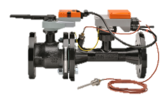
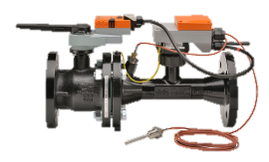
Pricing ANSI 125
ACTUATOR PART # |  |  |  |  | ARX24-EV | GRX24-EV | AKRX24-EV | GKRX24-EV
MODEL # | GPM | SIZE | BODY PRESSURE RATING (PSI) | CLOSE-OFF PRESSURE (PSI)
EV250S-127 | 127 | 2.5” (65) | ANSI 125, STANDARD CLASS B | 100 | $8,451 |  | $9,760
EV300S-180 | 180 | 3” (80) |  |  | $10,968 |  | $12,278
EV400S-317 | 317 | 4” (100) |  |  |  | $12,727 |  | $14,350
EV500S-495 | 495 | 5” (125) |  |  |  | $15,749 |  | $17,372
EV600S-713 | 713 | 6” (150) |  |  |  | $20,132 |  | $21,756
5 Models
Sizes: 2½” to 6”
Flow Range: 127 GPM to 100 GPM

Slide 43
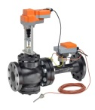
Pricing ANSI 250
ACTUATOR PART # |  |  |  |  | EVX24-EV-L | EVX24-EV-B | AVKX24-EV-L | AVKX24-EV-B
MODEL # | GPM | SIZE | BODY PRESSURE RATING (PSI) | CLOSE-OFF PRESSURE (PSI)
EV250S-127-250 | 127 | 2.5” (65) | ANSI 250, Standard Class B | 310 | $12,210 |  | $13,755
EV300S-180-250 | 180 | 3” (80) |  |  | $14,735 |  | $16,280
EV400S-317-250 | 317 | 4” (100) |  |  |  | $16,964 |  | $18,509
EV500S-495-250 | 495 | 5” (125) |  | 296 |  | $21,335
EV500S-495-250 | 495 | 5” (125) |  | 202 |  |  |  | $22,880
EV600S-713-250 | 713 | 6” (150) |  | 215 |  | $25,133
EV600S-713-250 | 713 | 6” (150) |  | 135 |  |  |  | $26,678
7 Models
Sizes: 2½” to 6”
Flow Range: 127 GPM to 100 GPM

Slide 44
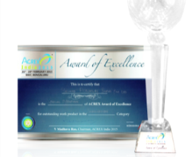


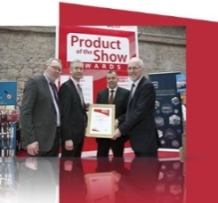
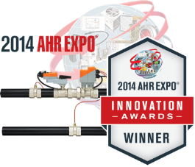
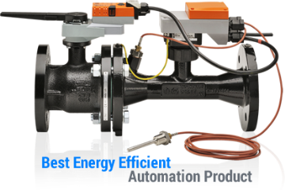
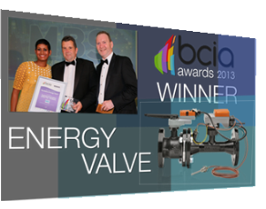


Industry Recognition
ACME 2016
Winner of Innovation Award
Acrex 2015
Winner of award of excellence
ControlTrends 2014
Energy Saving Product of theYear
ControlTrends 2012
Best commercial product of the year
2015 Energy Show
Best Energy Efficient Product
2017 AHR Innovation Award
Finalist in the Category of Building Automation
2014 AHR Innovation Award
Winner in the Category of Building Automation
2013 Building Efficiency Award
Best energy efficient automation product
Silver Trophy
BCIA Awards 2013
Technical Innovation of the Year
HVR Awards 2012
Air-conditioning product of the year
Shanghai Energy IAC 2014
Golden Key Award
Silver Trophy Award 2013
Winner of Energy Smart Automation Award

Slide 45
For more information and access to useful tools and resources, visit energyvalve.com
FIND US
BELIMO Americas
33 Turner Road
Danbury, CT 06810
CONTACT
Phone: +1-800-543-9038
Fax: +1-800-228-8283
E-mail: marketing@us.belimo.com
WEBSITE
www.belimo.us

